Slide 1

Introduction to Ludwig Center at Harvard
Cancer Research Collaborative
Joan Brugge, PhD
George Demetri, MD

Slide 2
Ludwig Cancer Research
International community of distinguished scientists dedicated to preventing and controlling cancer
Founded by D.K. Ludwig
  Born in Michigan, 1897; died in NYC, 1992
  Self-made billionaire, shipping entrepreneur
Provides scientists worldwide with resources and flexibility to realize the life-changing potential of their work
Basic and translational research
Encompasses the Ludwig Institute and the Ludwig Centers – more than 600 scientists worldwide
Invested $2.5 billion in cancer research to date

Slide 3
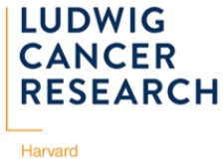
Opportunity at HMS and HMS-affiliated Institutions
With senior leaders across HMS and the Boston academic community, we have discussed extensively how best to build the HMS Ludwig Center within the unique environment of the Harvard community in order to have maximum impact on cancer.
Factors we considered:
  Extraordinary breadth and depth of basic, translational and clinical investigators across Harvard
  Bring in the most diverse set of perspectives, skills and people to develop new ways of addressing a major problem in cancer
  Enable a novel approach to “resistance” in cancer

Slide 4
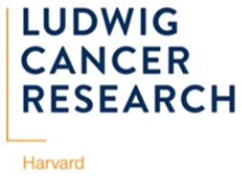
Background
Endowment funds are dedicated to supporting cancer research
  Endowment invested in Harvard Management Fund generates current-use funds to support research long-term
Full endowment now allows the Ludwig Center at Harvard to engage a larger community of HMS investigators
  Since initiation, research funding has been provided to investigators and projects at BWH, DFCI, MGH, and HMS
The evolution of Ludwig-supported research in the US and worldwide offers opportunities to enhance communication and collaboration across HMS and link to Ludwig-affiliated investigators outside Harvard

Slide 5
Ludwig Center at Harvard
Cancer Research Collaborative
Overarching goal: to develop strategies that will overcome resistance that limits the efficacy of anticancer therapies.
While significant advances have been made in the treatment of cancer, intrinsic and acquired resistance remain major challenges to reducing the cancer burden.
The Ludwig Center at Harvard seeks new ways to understand and address the basic science and clinical problems of resistance to therapeutic interventions

Slide 6
Ludwig Center at Harvard
Cancer Research Collaborative
Key aspects of this initiative:
engagement of a broad spectrum of Harvard faculty from the earliest stages of the project conception and design
cross-fertilization at embryonic stage of project development and continued close engagement of investigators as work proceeds
develop new ways of thinking about resistance to unravel the complexities of the resistant states from many different perspectives.
  Ludwig’s unique funding model makes it feasible create the infrastructure, incentives, and cultural changes required to build and sustain effective interdisciplinary collaborations in academia.

Slide 7
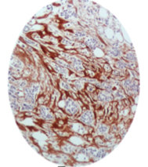
Challenge: Tumor resistance is mediated by MANY different factors
Stochastic variation in gene/protein expression
Immune escape and suppression
Microenvironment
Phenotypic/Epigenetic alterations (state of differentiation, quiescence or dormancy)
-Matrix
- Myofibroblasts
- Immune cells
- Hypoxia
- Acidity
Physical/chem barriers to drug delivery/efficacy
Drug induced Adaptive changes
Intrinsic or acquired genetic alterations
- Biomechanical forces
- Drug pumps
- Drug metabolism
Notes:
Like to show just a few slides to provide the rationale for the specific challenge that we would like to present to the HMS community.
Cancer therapy resistance poses a significant challenge because there are many distinct drivers that regulate programs that protect tumor cells from stresses associated with cancer therapies. These include diverse genetic, epigenetic, and stochastic alterations within tumors, as well as a broad spectrum of factors contributed by many diverse cells that are recruited to the tumor microenvironment.
Many distinct drivers regulate programs that protect tumor cells from stresses associated with tumorigenesis and cancer therapies. These include diverse genetic, epigenetic, and stochastic alterations within tumors, as well as a broad spectrum of factors contributed by many diverse cells that are recruited to the tumor microenvironment.

Slide 8
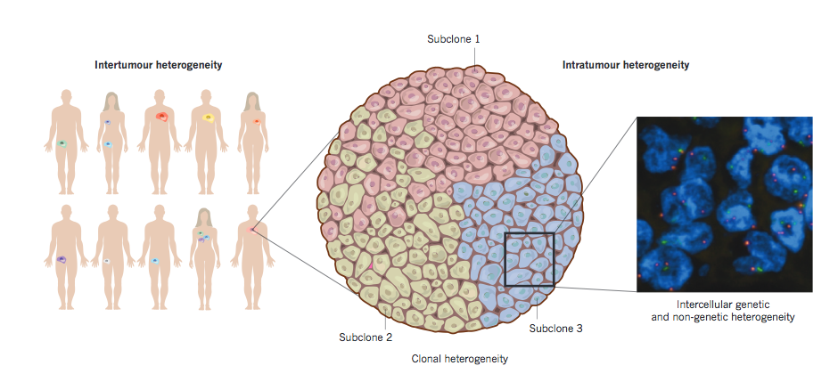
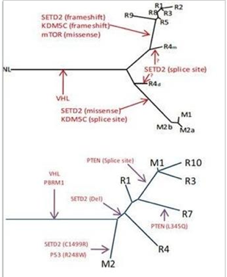
Genetic intratumoral heterogeneity adds significant Complexity
Modified from Burrell et al Nature 2013
Notes:
Therapy resistance is further complicated by tumor heterogeneity– this includes heterogeneity between tumors from different individuals, but even more significantly, within an individual tumor, and between tumors at different sites in the same patient.
Recent evidence has shown that the many cells in many tumors do not share a common set of mutations and that multiple branched genetic lineages exist within different regions of each tumor and at metastatic sites of the same tumor. This genetic heterogeneity generates significant diversity in responses to cancer therapies.
In addition to the genetic heterogeneity, tumor cells with the same genetic constitution can exist in different states that reflect their differentiated phenotype, their response to matrix and paracrine factors derived from cells within the microenvironment, and stochastic changes in cell state – adds significantcomplexity to the challenge of eliminating tumors
Mention that most efforts in targeted therapies have been directed towards the driver mutations – had enormous success in shrinking tumors – but most tumors return –
Through the ludwig, we would like to bring new perspective to this problem by assembling a community of investigators with

Slide 9
Factors that drive therapy resistance feed into common underlying cellular programs that are targets for intervention
Intrinsic or acquired genetic alterations
Microenvironment factors- cell & ECM
Epigenetic phenotypic variants
Stochastic variants
Drug-induced adaptive changes
Inputs
Programs regulated by inputs that control cell survival in response to therapy
Resistant state
SURVIVAL

Slide 10
The challenge to HMS investigators
Want to bring new perspective and understanding to what defines “resistant states” for cancer cells
Define the programs and pathways which contribute to establishing and maintaining “resistant states” in cancer(s)
Identify and develop new tools for understanding basic and clinical principles of resistant states
Develop a resource of clinical material and high-fidelity models along with informative clinical annotation to advance the field
DEVELOP EFFECTIVE STRATEGIES TO IMPROVE CURRENT AND EXISTING THERAPIES

Slide 11
Launching the collaborative: Process
Discuss the organization and overall scientific theme with
leaders across HMS and affiliated centers
Prepare statement on the scientific theme / challenge
Visit basic and clinical research groups across HMS and affiliates to describe vision, goals, and organization
Open submissions of short description of novel ideas and approaches to address the research challenge

Slide 12
An experiment in research process
Build a community of investigators with diverse backgrounds, perspectives, and skills who want to work together
  Dedicated time together
  (weekly meetings to ensure engagement)
  Develop strategies by cross-fertilization of
  ideas and approaches across investigators
Support with relevant resources
  Innovation fund to allow new approaches as teams evolve
Include major symposia at HMS to strengthen community

